Slide 1


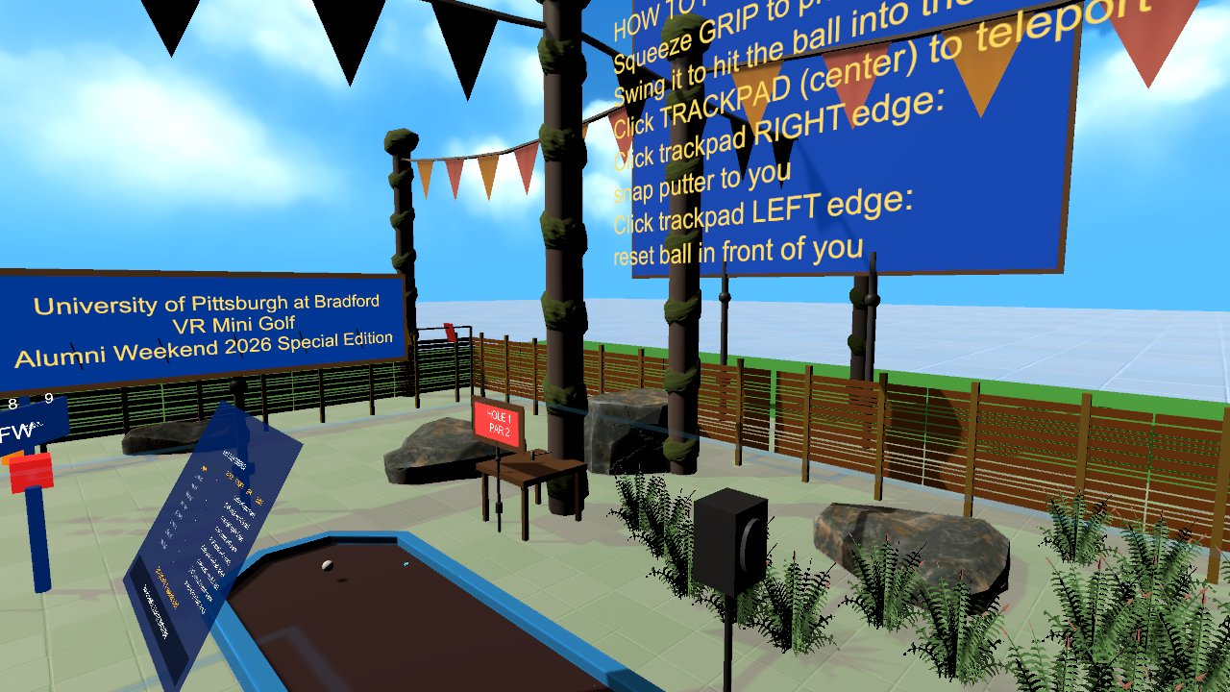

Virtual Reality
Scene Creation II: components, colliders, materials, prefabs, Asset Store, lighting
Wednesdays at 6:00pm
CIST 1423 - 2010 VIRTUAL REALITY PROGRAMMING AND TECHNOLOGY
Exam 1 this week: Ch. 1–2
Notes:
Syllabus Week 3: Ch. 2 second half. Title image: GolfVR festive entrance plaza (Asset Store packs + lighting).

Slide 2



Agenda
Components & colliders
Materials, prefabs, Asset Store
Lighting & probes
GameObjects are containers; physics needs colliders
Reuse other people's work without breaking yours
Realtime vs baked, light and reflection probes

Slide 3

Today
By the end of class you can…
Explain what a component is, and add colliders, Rigidbodies and triggers correctly
Tonight's plan
1
0–10
Review
Set up PBR materials (albedo, metallic, smoothness, normal map)
2
10–45
Components, colliders, materials, prefabs
45–60
Lighting and probes
Place, override and unpack prefabs; import only what you need from the Asset Store
3
60–100
Exam 1 (Ch. 1–2)
Choose realtime vs baked lighting, and use light and reflection probes
100–145
Lab: extend your Week 2 scene
4
145–150
Exit ticket
CIST 1423 — Week 3 — The Unity Editor & Scene Creation II (Ch. 2, second half)

Slide 4




A GameObject is a bag of components
Every object has a Transform; everything else is a component you add.
Transform
Mesh Filter + Renderer
Collider
Your scripts
Position, rotation, scale
Parent/child: children move with parents
Local vs world space
What shape (mesh)
How it looks (material)
No renderer = invisible
The shape physics sees
Box / Sphere / Capsule / Mesh
Can be a trigger
A MonoBehaviour is a component too
Awake → Start → Update
Public fields show in the Inspector
Week 2 lab: ground, table, sphere were each "primitive + components". This week we add behaviour and looks.
CIST 1423 — Week 3 — The Unity Editor & Scene Creation II (Ch. 2, second half)
Notes:
Show the Inspector for a Week 2 primitive and add/remove components live.

Slide 5
Colliders, Rigidbodies, and which callback fires
At least one of the two objects needs a Rigidbody for any of these to fire.
You want… | Setup | Callback | Example in our code
Solid bumps | Collider + Rigidbody | OnCollisionEnter(Collision) | GolfPutter hits GolfBall
"Did something enter this zone?" | Collider with Is Trigger | OnTriggerEnter(Collider) | ObstacleAnimator zones
"Is it still inside?" | Trigger | OnTriggerStay: careful! | GolfHole cup (see note)
Static scenery | Collider, no Rigidbody | — | Course walls, table
Scripted movement that still pushes | Rigidbody (Is Kinematic) | Collision on the other body | A held putter
Real bug from GolfVR: Unity stops sending OnTriggerStay to a sleeping Rigidbody, so a ball at rest in the cup never "arrived". The fix checks distance in FixedUpdate.
CIST 1423 — Week 3 — The Unity Editor & Scene Creation II (Ch. 2, second half)
Notes:
GolfHole.cs comments explain the sleeping-rigidbody issue. Great exam-style question.

Slide 6




Materials: how a surface responds to light
Built-In "Standard" vs URP "Lit" shader: same ideas, different shader names.
Albedo / Base Map
Metallic + Smoothness
Normal map
Pink = wrong pipeline
The colour (or texture)
Our Pitt finishes: #003594 blue, #FFB81C gold
Metal reflects its surroundings
Smoothness = sharp vs blurry highlights
Gold statue: metallic 0.85
Fake bumps without extra polygons
Panther scan keeps its normal map across finishes
Material uses a shader the render pipeline can't draw
Edit → Rendering → Materials → Convert…
CIST 1423 — Week 3 — The Unity Editor & Scene Creation II (Ch. 2, second half)
Notes:
Same PBR parameters as three.js MeshStandardMaterial in panther-builder (constants.js).

Slide 7

Prefabs and the Asset Store
A prefab is a reusable GameObject template. Asset Store packs are mostly prefabs.
Import
Place
Override
Unpack
Window → Package Manager → My Assets → Download → Import. Untick what you don't need.
Drag a prefab from Project into the Scene. Blue icon = linked instance.
Change the instance; bold values are overrides. Overrides → Apply to push back.
Right-click → Prefab → Unpack (one level) or Unpack Completely: now a plain GameObject.
Repo hygiene lesson from GolfVR
Asset Store packs brought ~1.37 GB into the project. Tracing references from every scene showed ~870 MB was never used (demo scenes, 4K textures), so those folders are git-ignored. Import only what you use.
CIST 1423 — Week 3 — The Unity Editor & Scene Creation II (Ch. 2, second half)
Notes:
The .gitignore at the repo root documents the unused-pack folders and how they were found.

Slide 8
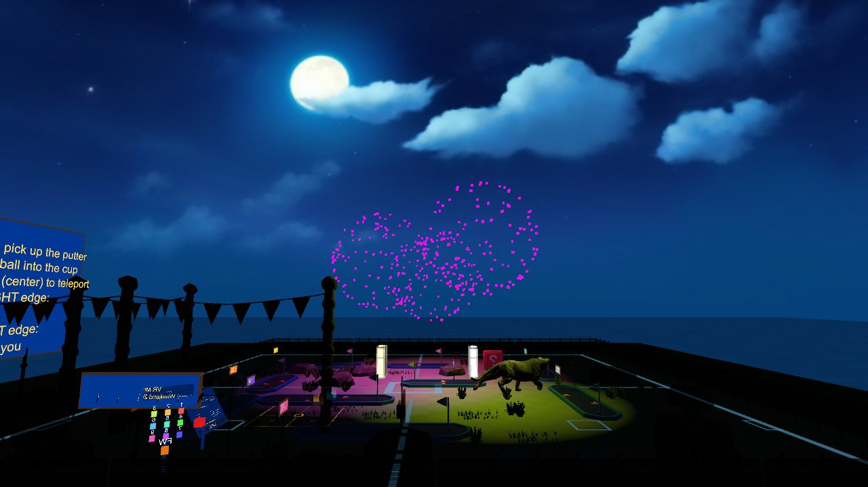



Lighting: realtime, baked, mixed
Light types
Directional (sun), Point, Spot, Area (baked only)
Realtime vs baked
Realtime: moves, costs every frame
Baked: precomputed lightmaps, cheap, static only
Mixed: bake indirect, keep direct shadows live
Probes
Light probes: baked light for moving objects
Reflection probes: what shiny things reflect
GolfVR fades the skybox and ambient light to night for its fireworks: all done by changing lighting at runtime.
CIST 1423 — Week 3 — The Unity Editor & Scene Creation II (Ch. 2, second half)
Notes:
VR needs 90 Hz, so baking is a big win. RenderSettings.skybox / ambientIntensity are changed in FireworksCelebrationController.

Slide 9



Exam 1 review: Ch. 1–2
Know these cold.
XR vocabulary
The Editor
Scene building
VR vs AR vs MR
Stereo rendering, 6DOF vs 3DOF
Headsets: Quest 2, Vive Pro 2, HoloLens
Hierarchy, Scene, Game, Inspector, Project
Grid and Snap
Render pipelines: Built-In vs URP vs HDRP
Components and Transforms
Colliders, triggers, Rigidbodies
Materials, prefabs, lighting, probes
CIST 1423 — Week 3 — The Unity Editor & Scene Creation II (Ch. 2, second half)
Notes:
Exam 1 in class this week.

Slide 10
Check your understanding
Answer with a partner first, then we'll compare.
Q1
Q2
Two objects collide. Neither has a Rigidbody. Does OnCollisionEnter fire?
Why did GolfVR stop relying on OnTriggerStay for the cup?
Q3
Q4
A material shows pink. What happened?
When do you need a light probe?
CIST 1423 — Week 3 — The Unity Editor & Scene Creation II (Ch. 2, second half)
Notes:
Answers:
Q1. Two objects collide. Neither has a Rigidbody. Does OnCollisionEnter fire?
No: at least one of the two needs a Rigidbody.
Q2. Why did GolfVR stop relying on OnTriggerStay for the cup?
Unity stops sending it to a sleeping Rigidbody, and a ball at rest in the cup is exactly that case.
Q3. A material shows pink. What happened?
Its shader doesn't match the render pipeline (e.g. Built-In material in URP). Convert it.
Q4. When do you need a light probe?
For moving objects in a scene with baked lighting, so they receive the baked light.

Slide 11

Next steps: homework + planning
Extend your Week 2 scene: a custom material, one imported Asset Store object, adjusted lighting
Document it in Markdown with before/after screenshots
Exam 1 covers Ch. 1–2
Next week: VR Development in Unity I, SteamVR setup
CIST 1423 — Week 3 — The Unity Editor & Scene Creation II (Ch. 2, second half)

